Slide 1
Secure data Hiding in Images using steganography
CAPSTONE PROJECT
Presented By
Student Name : Samaksh Yadav
College Name & Department : VIT Chennai - EEE

Slide 2
OUTLINE
Problem Statement
Technology used
Wow factor
End users
Result
Conclusion
Git-hub Link
Future scope

Slide 3
Problem Statement
In today's digital age, the risk of confidential data leakage is a significant concern. To address this issue, the project aims to develop an effective steganographic system capable of concealing sensitive information within digital images. By embedding data covertly into images, the system ensures that the hidden information remains undetectable to unauthorized users, thereby enhancing data confidentiality and mitigating the risks associated with data leakage

Slide 4
Technology used
This project aims to develop a steganographic system to securely embed confidential information within digital images.
It will include advanced embedding and extraction algorithms to ensure the hidden data is resistant to detection and unauthorized access.
The project will enhance data security and privacy, addressing the increasing concern of data breaches by providing a covert method for data protection.
This innovative approach addresses the growing concern of data breaches, offering a covert and reliable solution for protecting sensitive information.
Tools and Libraries:
Python: Primary programming language.
OpenCV: For image processing.
hashlib: For SHA-256 password hashing.

Slide 5
Wow factors
Enhanced Security: Protects sensitive data from unauthorized access.
Practical Application: Suitable for government, businesses, healthcare, and individuals.
User-Friendly: Simple interface for secure data embedding and retrieval.
Reliable and Robust: Ensures confidential communication and data storage without noticeable image distortion.

Slide 6
End users
Government Agencies: For securely transmitting classified information.
Businesses: To protect sensitive corporate data and intellectual property.
Healthcare Providers: For safeguarding patient records and confidential medical information.
Military: For secure communication and strategic information sharing.
Journalists: To protect sources and sensitive data.
Financial Institutions: For secure transmission of financial data.
Individuals: For personal data security and privacy in digital communication.
Digital Forensics Experts: For investigating digital crimes without alerting suspects.

Slide 7
Results
Secure Data Embedding: Implemented robust encryption to securely hide messages in images using SHA-256 hashing.
Quality Preservation: Maintained image quality and ensured hidden data is imperceptible.
Reliable Decryption: Developed effective decryption algorithms for accurate message retrieval.
User-Friendly: Created easy-to-use scripts for encryption and decryption, accessible to non-technical users.
Versatile Applications: Demonstrated applicability in government, business, healthcare, and personal data security.

Slide 8
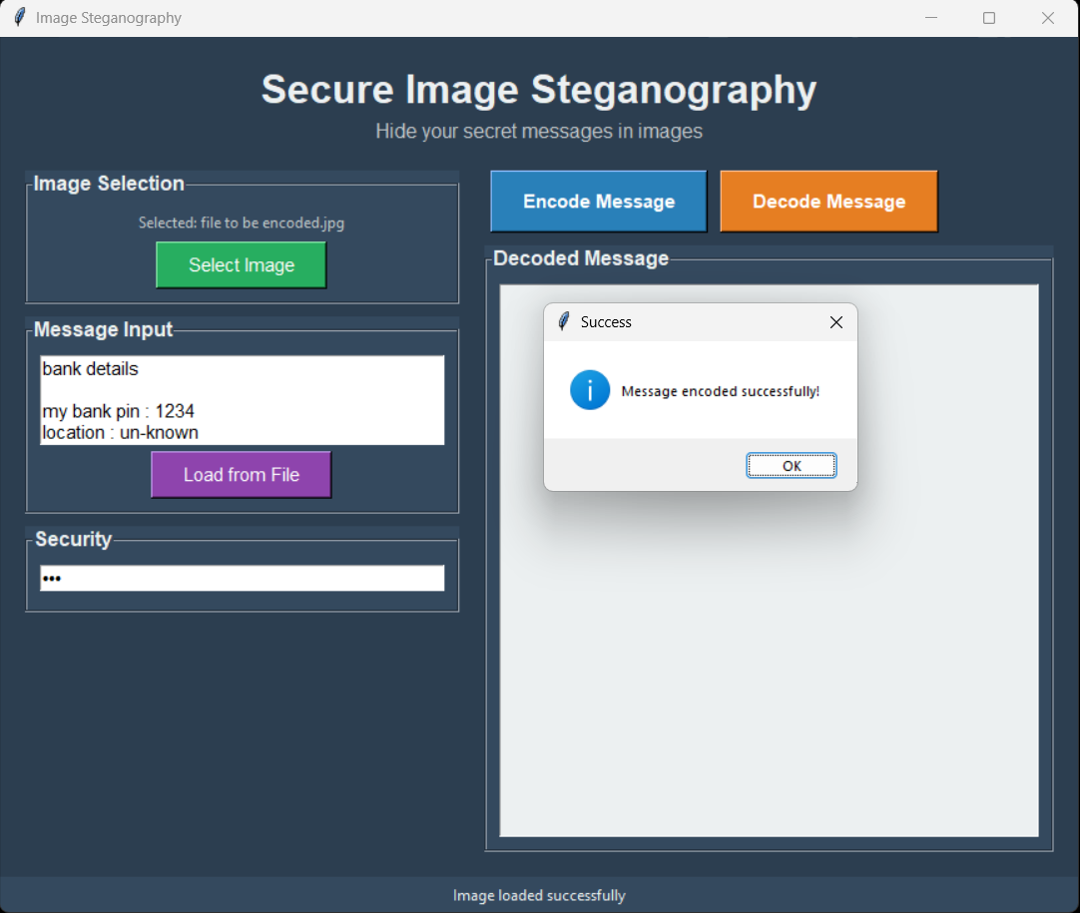
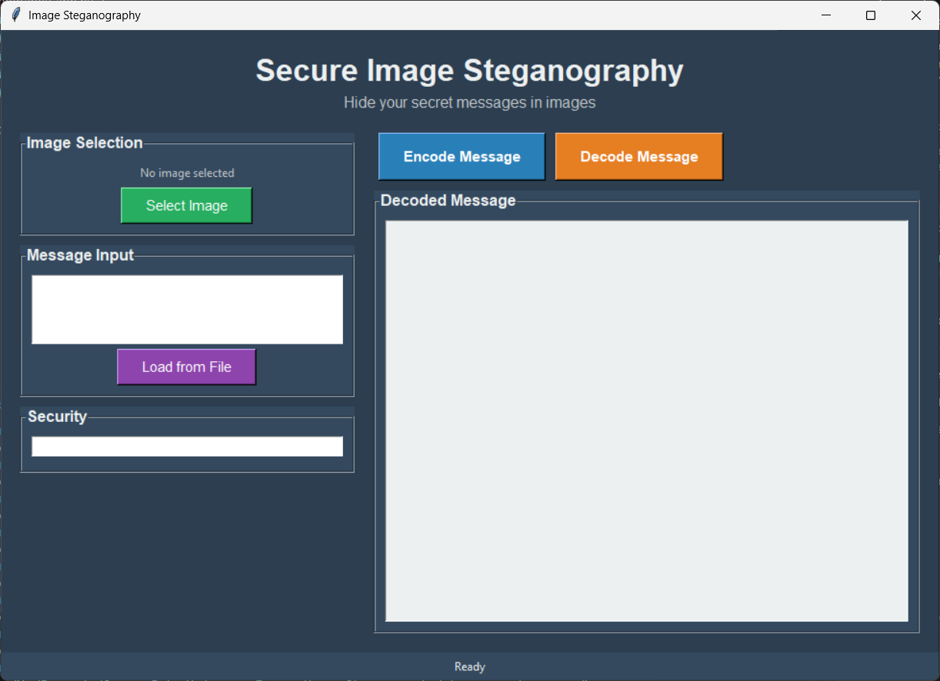
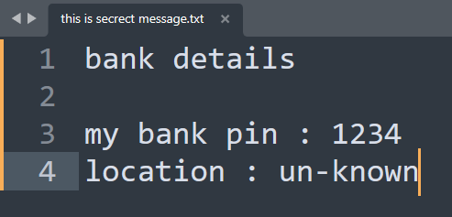
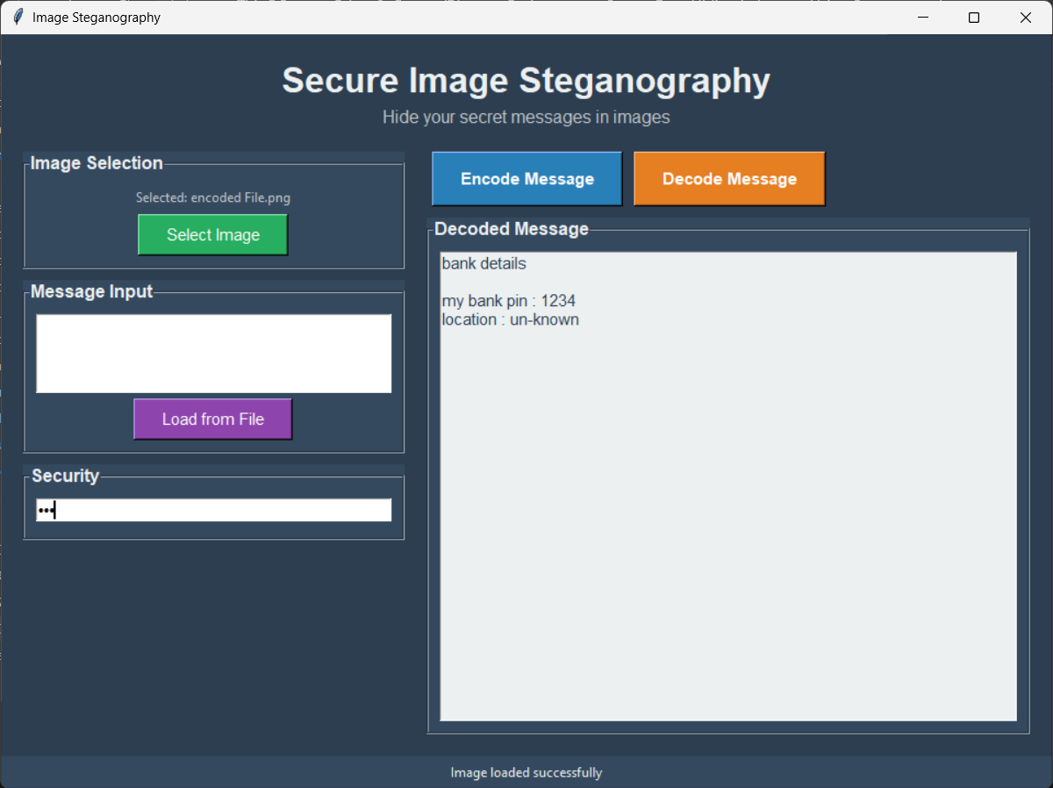
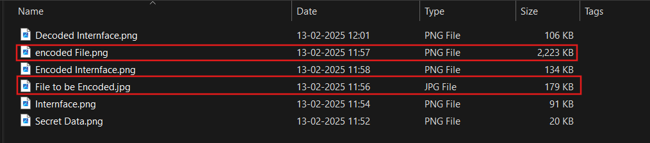
Results

Slide 9
Conclusion
This project uses steganography to securely hide data within images using SHA-256 hashed passwords. The encryption algorithm embeds secret messages into pixel values, ensuring data remains imperceptible. The decryption algorithm accurately retrieves hidden messages, maintaining image integrity.
Enhanced Security:
Implemented SHA-256 hashing for passwords to ensure secure data embedding and retrieval.
Efficient Algorithms:
Developed optimized encryption and decryption algorithms to embed and extract messages without compromising image quality.
Versatile Application:
Made the system compatible with common image formats, allowing for broad applicability across various use cases.
Robust Testing:
Conducted extensive testing to ensure the system’s reliability and resistance to potential attacks, enhancing overall robustness.

Slide 10
GitHub Link
https://github.com/SamakshY/cyber-security.git

Slide 11
THANK YOU

